Slide 1


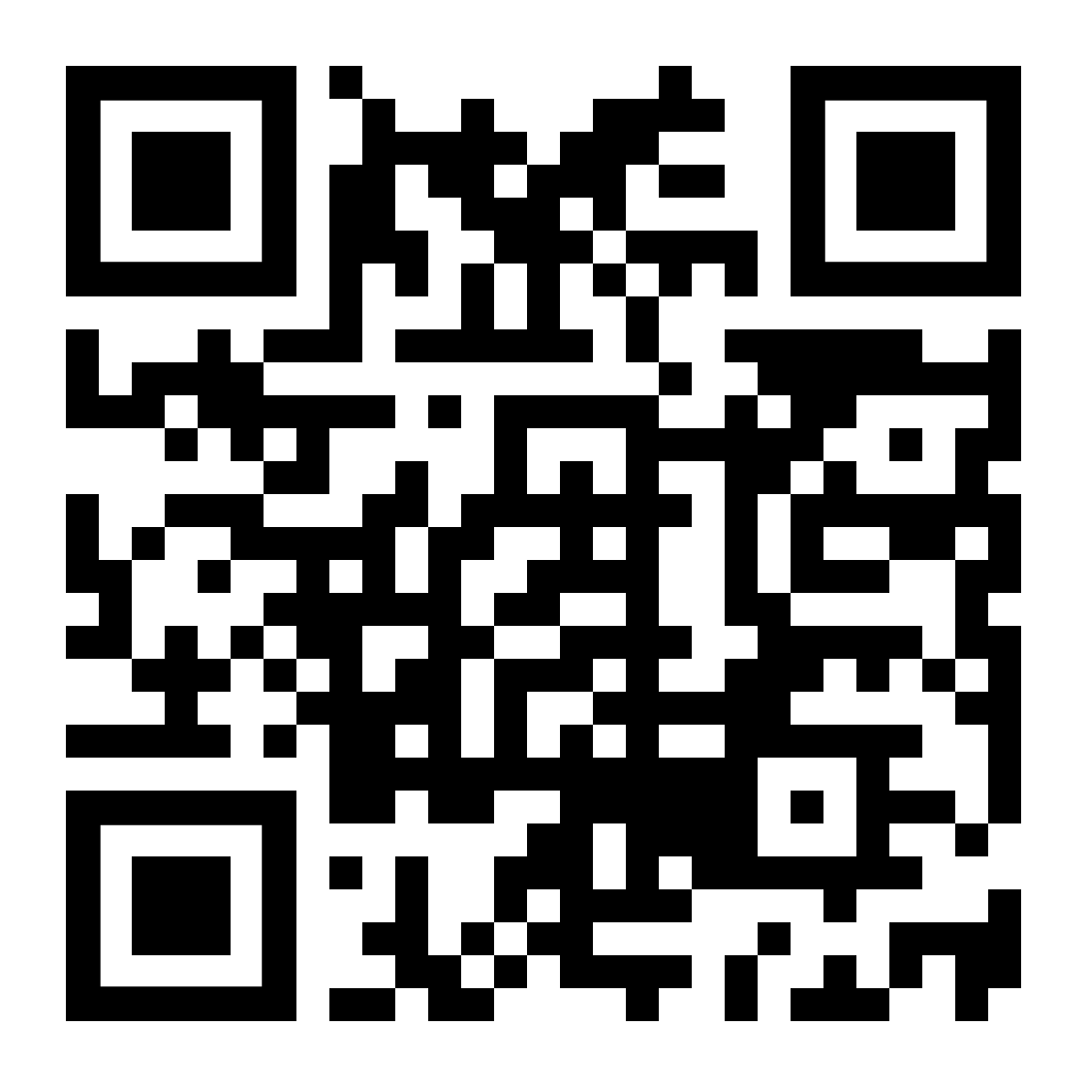



INTEGRATION PATTERNS IN MODULAR MONOLITH APPLICATIONS
Follow me on Twitter
Halil İbrahim KALKAN
Volosoft, Co-founder
@hibrahimkalkan
@hikalkan

Slide 2

TITLE
TODO

Slide 3
TITLE
TODO

Slide 4
TITLE
TODO

Slide 5
TITLE
TODO

Slide 6
TITLE
TODO

Slide 7
TITLE
TODO

Slide 8
TITLE
TODO

Slide 9
TITLE
TODO

Slide 10

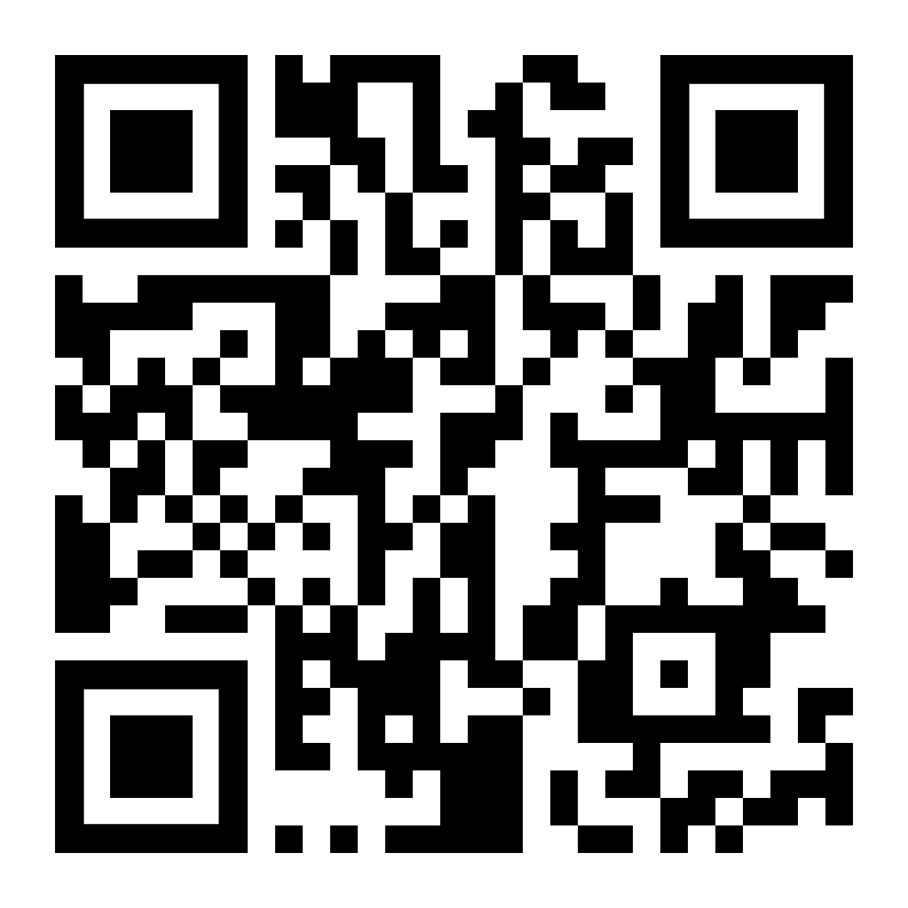
Download This Presentation
THANK FOR
WATCHING
Halil İbrahim KALKAN
Volosoft, Co-founder
@hibrahimkalkan
@hikalkan

